Slide 1
2. DPCM (Differential Pulse Code Modulation
DPCM: a procedure of converting an analog signal
into a digital signal in which an analog signal
is sampled and then the difference between
the actual sample value and its predicted
value (predicted value is based on previous
sample or samples) is quantized and then
encoded forming a digital value.
DPCM : code words represent differences between
samples,
unlike
PCM : where code words represented a sample value

Slide 2
Basic concept of DPCM : coding a difference, is based
on the fact that most source signals show
significant correlation between successive
samples so encoding uses redundancy in sample
values which implies lower bit rate.
Realization of basic concept : is based on a technique
in which we have to predict current sample value
based upon previous samples (or sample) and we
have to encode the difference between actual
value of sample and predicted value (the
difference between samples can be interpreted as
prediction error).
Because it's necessary to predict sample value
DPCM is form of predictive coding.

Slide 3
DPCM : Mengkodekan Perbedaan dua amplitudo sinyal sample
PAM yang berdekatan, yaitu sinyal sample sebelumnya
dengan sinyal sample berikutnya (yang disebut “
prediction error), dikuantisasi selanjutnya dikodekan
menjadi sinyal digital (code word) dan ditransmisikan.
    Perkiraan harga sinyal sample berikutnya dibuat
    berdasarkan atas harga sinyal sample terdahulu.

Slide 4
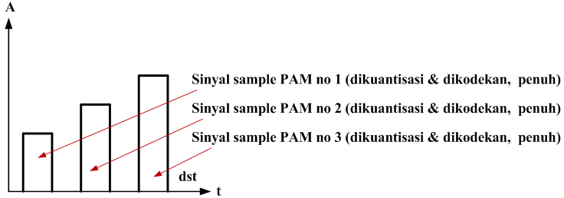
PCM : code words represented a sample value.

Slide 5
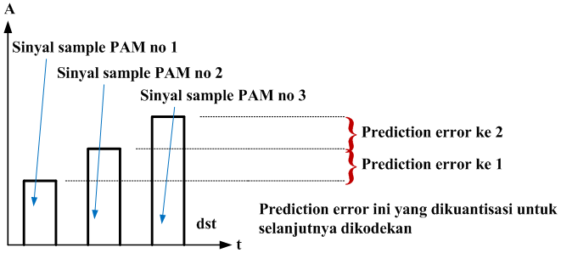
DPCM : code words represent differences between samples

Slide 6
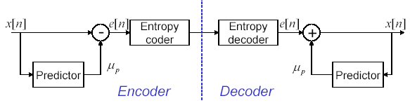
Reduksi Redundancy dg Prediction pd Lossless Coding
Principle
x[n] adalah sampel saat ini dari sinyal original
µ_{p} adalah prediksi utk x[n] dikalkulasi dari sampel sebelumnya
e[n] adalah prediction error, yg secara signifikan mengurangi statistical dependencies antar sampel berdekatan
Penerima dp merekonstruksi x[n] tanpa loss

Slide 7
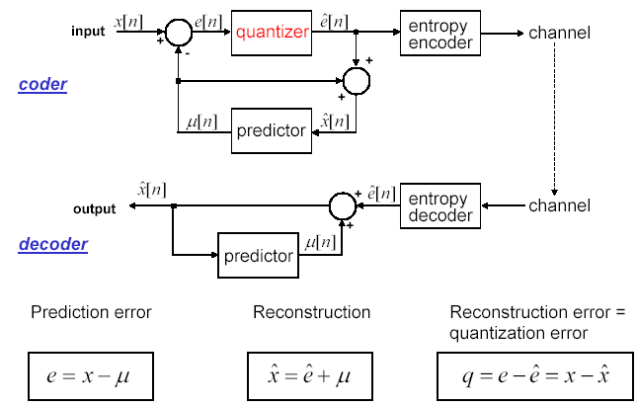
Prinsip DPCM

Slide 8
3. Modulasi Delta
Delta modulation (DM )is a subclass) of differential pulse code
modulation (DPCM).
It can be viewed as a simplified variant of DPCM, in which 1-bit
quantizer is used with the fixed first order predictor, and was
developed for voice telephony applications.
Principle of DM :
Transmits information only to indicate whether the analog signal that
is being encoded goes up or goes down.
The Encoder Outputs are highs or lows that “instruct” whether to go
up or down, respectively.
DM output is 0 if waveform falls in value.
DM output is 1 represents rise in value.
Each bit indicates direction in which signal is changing
(not how much), i.e.
DM codes the direction of differences in signal amplitude instead of
the value of difference (DPCM).

Slide 9
The analog signal is quantized by a one-bit ADC (a comparator
implemented as a comparator).
The comparator output is converted back to an analog signal
with a 1-bit DAC, and subtracted from the input after passing
through an integrator.
The shape of the analog signal is transmitted as follows:
    a "1“ indicates that a positive excursion has occurred
    since the last sample,
    and a "0" indicates that a negative excursion has
    occurred since the last sample.

Slide 10
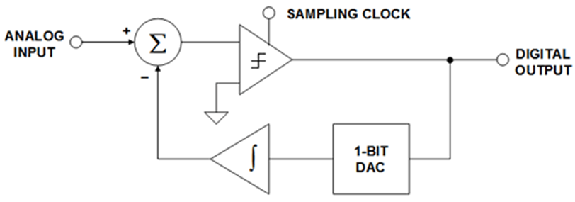


Slide 11
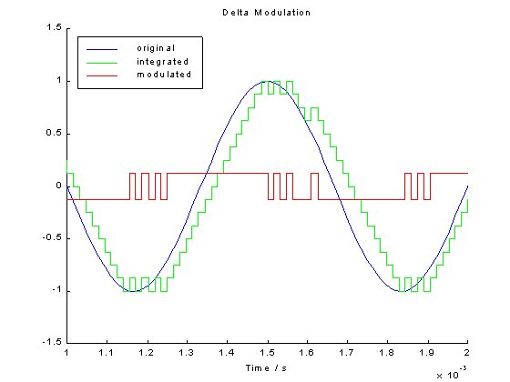
Resulting Waveforms

Slide 12
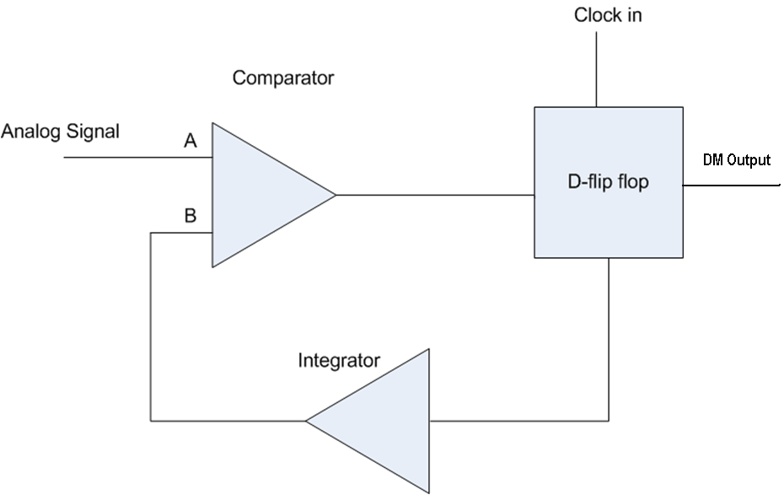
Simple Implementation of a DM system

Slide 13
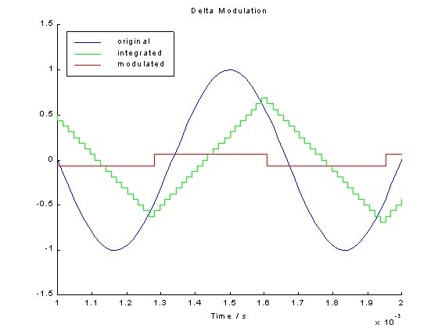
Limitations of the system

Slide 14
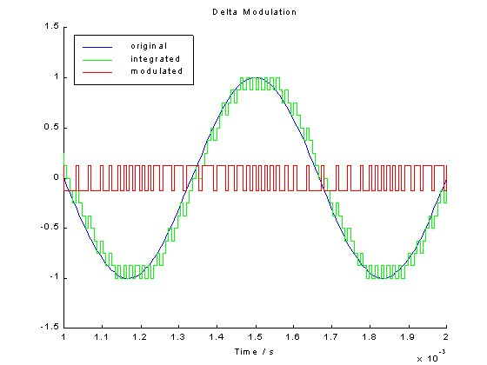

Slide 15
The codec determines if the waveform has risen or
dropped one delta step.
Transmit a 1 or 0 accordingly.
Delta Modulation requires only 1 bit sample.
Delta modulation is faster than PCM.
Slope overload noise: waveform rises or drops too
quickly, the codec not able to keep up with the
change.
Constant waveform: A non-changing waveform
generates a pattern of 01010101... thus generating
quantising noise atau Granular noise.

Slide 16
